Slide 1

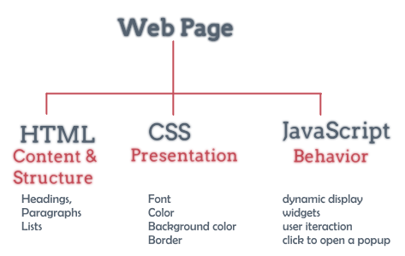
Cascading Style Sheets (CSS) Part 1

Slide 2
Lesson Objectives
Understanding the concept of CSS language
Understand the rules and syntax of the CSS language
Know how to apply CSS language to support web interface design

Slide 3
Lesson content
DHTML concept
Introduction to CSS
How CSS works
Syntax- CSS rules
CSS classification and usage
Details of commonly used elements in CSS

Slide 4
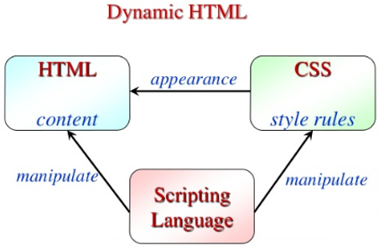
1. DHTML concept
DHTML (Dynamic HyperText Markup Language)
HTML
Scripts
CSS

Slide 5
2. Introduction to CSS
CSS - Cascading Style Sheets
Used to describe how to display elements on a WEB page
Use the same as the TEMPLATE
Can be reused for other sites
Can change the attribute of each page or the whole site quickly (cascading)
The style sheet defines the layout, presentation, colors, etc. for HTML tags
For example: for pink body tag, red p tag, Times New Roman font type, italic type, etc.

Slide 6

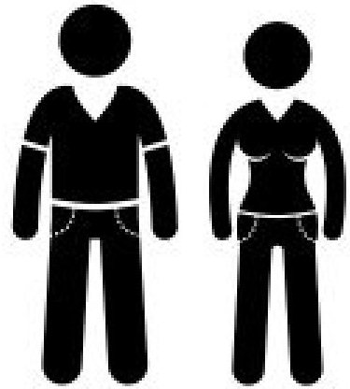

2. Introduction to CSS
+ CSS
HTML

Slide 7
2. Introduction to CSS
Advantages:
Better control over page layout, font design and typography
Easier to keep the site up and running
Type information is separated from the site structure
Weakness:
Not widely supported, or not fully supported
Browser dependency

Slide 8
3. How CSS Works
The browser generates the element from HTML, formatted with styles in CSS.
Order of precedence (descending):
Inline styles
External Style Sheet
Browser Default Styles
Internal Style Sheet

Slide 9
4. Syntax- CSS creation rules
The syntax of CSS is usually organized into three parts: selectors, properties, and values:
selector {property: value}
p
{
text-align: center;
color: black;
font-family: arial
}
body {color: black}
p {font-family: "sans serif"}
p {text-align:center; color:red}

Slide 10
4. Syntax- CSS creation rules
Magnitude value:
Px - Pixel – Smallest unit
Pc - pica - 1pica = 4.23333333 millimet -
In - inch - 1 inch = 2,54 centimet
Mm - milimet
Cm - centimet
Percent %
Relative:
Larger
Smaller
Absolute size: xx-small,x-small,small,medium, large, x-large, xx-large

Slide 11
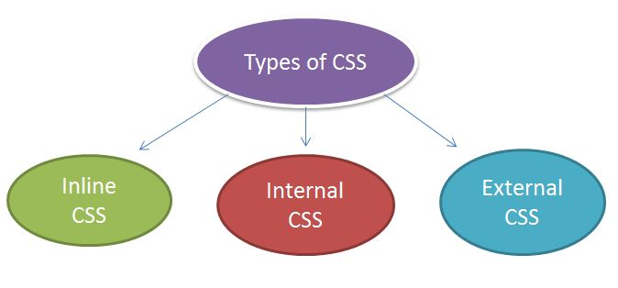
5. CSS classification and usage
There are 3 types of CSS:
Type 1: Inline Style Sheet
Type 2: Internal Style Sheet
Type 3: External Style Sheet

Slide 12
Type 1: Inline Style Sheet
Defined in the style attribute of each HTML tag
Syntax :
<TagName style="property1:value1; property2:value2; ……..; propertyN:valueN;">
Data
</TagName>
For example:
<p style="color: red; margin-left: 20px; font-size: 48px;"> This is a paragraph </p>

Slide 13
Type 2: Internal Style Sheet
Embed in the <style> tag of the HTML page (placed in the <head>)
<head>
<style type=“text/css” >
SelectorName
{
property1: value1;
property2: value2;
………
propertyN: valueN;
}
</style>
</head>

Slide 14
Type 2: Internal Style Sheet
For example :
<head>
<style type="text/css“>
p
{
color:blue;
font-size:14pt;
font-family:Verdana;
text-align:center
}
p.left{text-align:left}
</style>
</head>
<body>
<p> CSS according to ESS, design in p tag, blue font size 14 </p>
<p class=“left”> In class left </p>
</body>

Slide 15
Type 3: External Style Sheet
All styles are saved in a file with the extension *.css
Syntax like in Internal CSS
Link by tag link:
<head>
<link rel="stylesheet" href="URL" type="text/css">
</head>
Link with style tag using @import url.
<head>
<style type="text/css">
@import url(URL);
</style>
</head>

Slide 16
Type 3: External Style Sheet
Example: Using a separate CSS file saved in the same web directory:
file “ex1.css”:
body {background-color: yellow} h1 {font-size: 36pt}
h2 {color: blue}
p {margin-left: 50px}
<head>
<link rel="stylesheet" type="text/css" href="ex1.css" /> </head>
<body> <h1>This header is 36 pt</h1>
<h2>This header is blue</h2>
<p>This paragraph has a left margin of 50 pixels</p> </body>
Attention: not separate
Another ways:
<style …>
@import url(ex1.css);
</style>

Slide 17
Compare CSS Types
 | Inline CSS | Internal CSS | External CSS
Syntax | <p style=“color:red;”> Obama </p> | <style type=“text/css”> .Title1{color:red;} </style> <p class=“Title1”>Obama</p> | <link rel="stylesheet" type="text/css" href="ex1.css" /> <p class=“Title1”>Obama</p>
Advantage | Easy to manage Style according to each tag of Web documents Has the highest priority | Easily manage Styles for each Web document. No need to download additional information pages for Style | Styles can be set for multiple Web documents Style information is cached by the browser
Disadvantage | It is necessary to manually re-declare the Style information in each Web document and other documents. Difficult to update Style | - Need to re-declare style information for other documents in each use | - It takes time to download *.css files and slows down web compilation in the browser for the first time using

Slide 18
6. Details of commonly used elements in CSS
CSS Comments
Declare Selector
Multiple style sheets
Class
Identification
Pseudo Class & Element
Child & Descendent Selectors
Group of commonly used attributes

Slide 19
CSS Comments
Comments like C#, Java…
/* This is a comment */
p
{
text-align: center;
/* This is another comment */
color: black;
font-family: arial;
}

Slide 20
Declare Selector
Basic rule (1 tag):
Selector
{
property1: value1;
property2: value2;
}
p
{
text-align: center;
color: black;
font-family: arial
}

Slide 21
Declare Selector
multiple tags:
Selector1, selector2, selector3
{
property1: value1;
property2: value2;
}
h1{color: green}
h2{color: green}
hr{color: green}
h1,h2,hr
{
color: green
}

Slide 22
Multiple style sheets
extenal style:
h3
{
color: red;
text-align: left;
font-size: 8pt
}
Internal style:
h3
{
text-align: right;
font-size: 20pt
}
color: red;
text-align: right;
font-size: 20pt

Slide 23
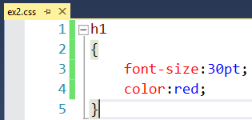
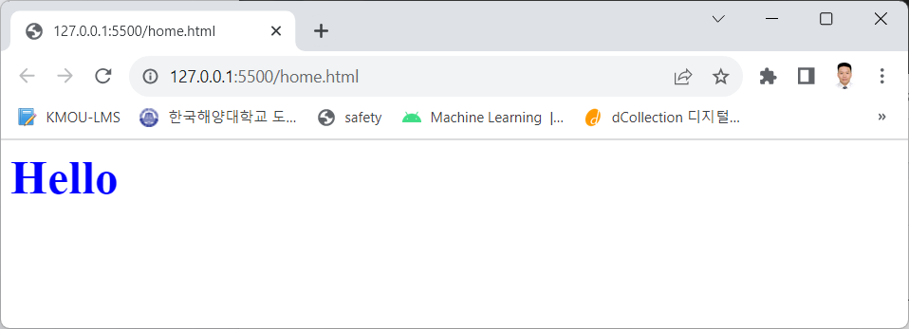
Multiple style sheets
<html>
<head>
<link rel="stylesheet" type="text/css" href="ex2.css"/>
<style>
h1{color: blue;}
</style>
</head>
<body>
<h1>Hello</h1>
</body>
</html>
External
Internal

Slide 24
Class
Declare the class associated with a specific tag:
tag_name.class_name
Declare a class without a tag:
.class_name
➔The class name should be meaningful, avoid starting with numbers as well as spaces (because sometimes some browsers do not support it)

Slide 25
Class
p.right {text-align: right}
p.center {text-align: center}
<p class="right"> This paragraph will be right-aligned. </p>
<p class="center"> This paragraph will be center-aligned. </p>
.can_giua {text-align: center}
<h1 class="can_giua">This heading will be center-aligned</h1>
<p class="can_giua"> This paragraph will also be center-aligned. </p>

Slide 26
Class
Tag with multiple classes?
dl.center{text-align: center;color: blue}
dl.bold {font-weight: bold}
<dl class="center bold"> DL including center and bold </dl>
p.right{text-align:right}
p.left{text-align:left}
<p class="left"> class left</p>
<p class="right"> class right</p>
<p class="right left"> class right, left</p>
???

Slide 27
Identification
Declare for specific tag
tag_name#indentification
General declaration
#indentification

Slide 28
Identification
#green {color: green}
p#para1
{
text-align: center;
color: red
}
<p id=“green”> Market News </p>
<p id=“para1”> Stock market </p>

Slide 29
Pseudo Class & Element
Pseudo class: identified by a colon
p:first-line { font-size: larger}
p:first-letter { font-size:24px;color:orange}
Formatting based on the state of the link, mouse events.
Can be combined with other Selectors. Commonly used with links
a:link
a:visited
a:hover
a:active

Slide 30
Pseudo Class & Element
Pseudo(pseudocode - /'sju:dəʊ kəʊd/ ) Element based on the first position of the character, of the line of text
:first-letter, :first-line
Can be combined with other Selector.
For example:
<style type="text/css">
div:first-line{font-size:24px; font-variant:small-caps}
div:first-letter{font-size:44px; color:red}
</style>
<div> The first line must be a line with font-size 24px, the first letter with font-size 44 px and what happens with the second? </div>

Slide 31
Child & Descendent Selectors
Child Selectors: Declare styles for elements located in a certain element (level 1)
parent > child { … }
ul
li
li

Slide 32
Child & Descendent Selectors
Descendent Selectors: Declare all elements that satisfy the condition in a certain element
parent descendent {…}
ul
li
ul
li
li
ol
li
li
li

Slide 33
Group of commonly used attributes
Group for background
Group for text
Group for border
Some other groups

Slide 34
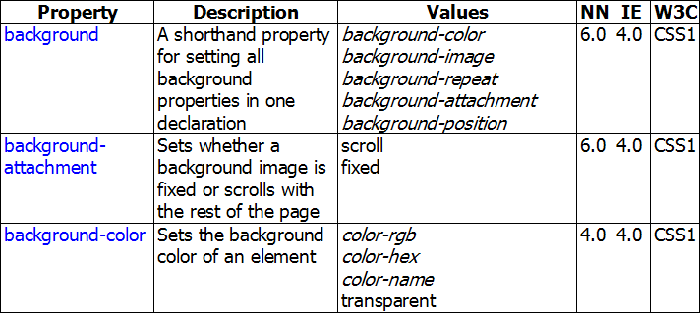
Group for background

Slide 35
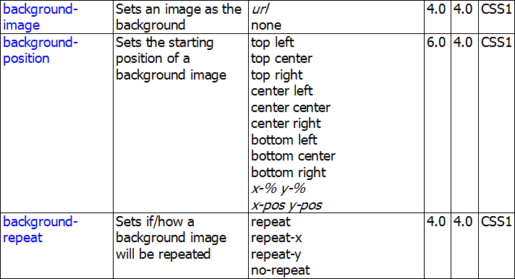
Group for background

Slide 36
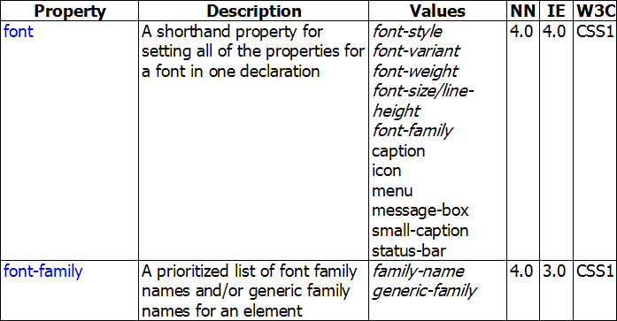
Group for text

Slide 37
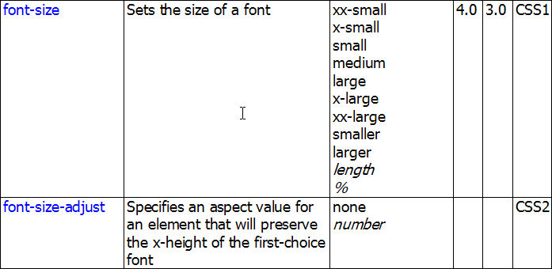
Group for text

Slide 38
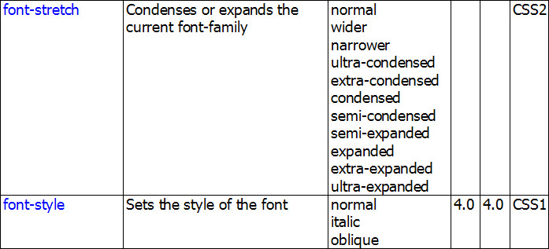
Group for text

Slide 39
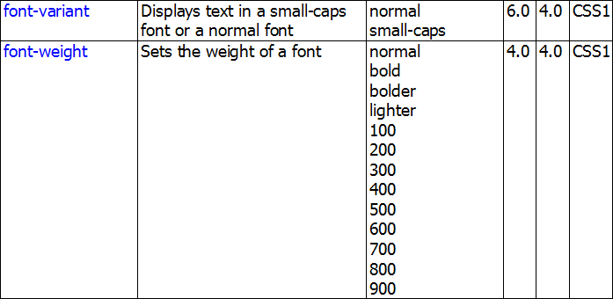
Group for text

Slide 40
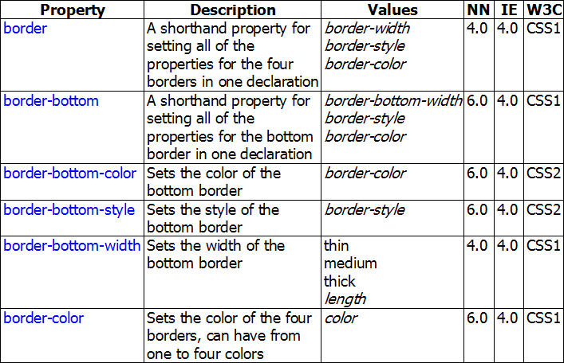
Group for border

Slide 41
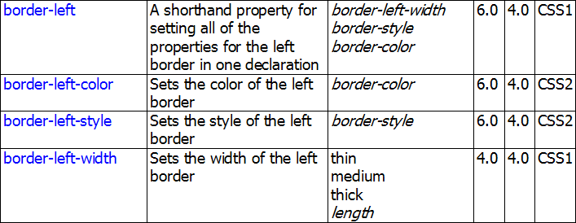
Group for border

Slide 42
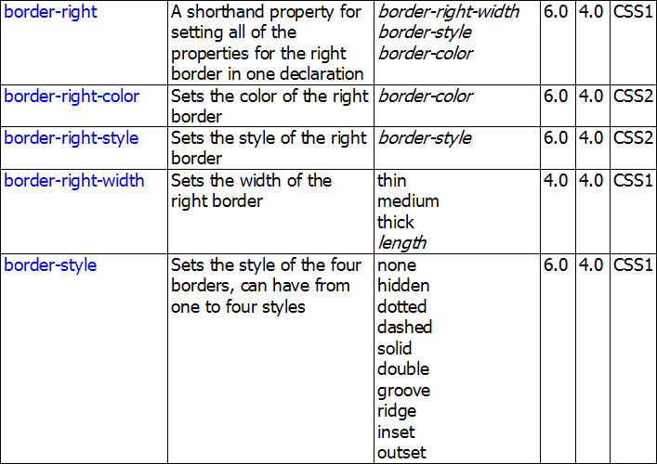
Group for border

Slide 43
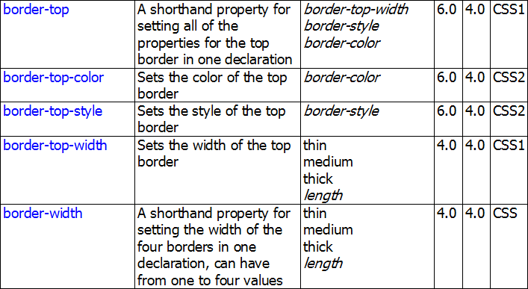
Group for border

Slide 44
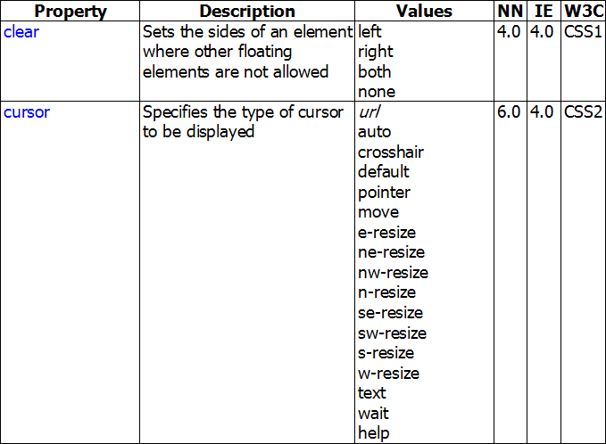
Other Attributes

Slide 45
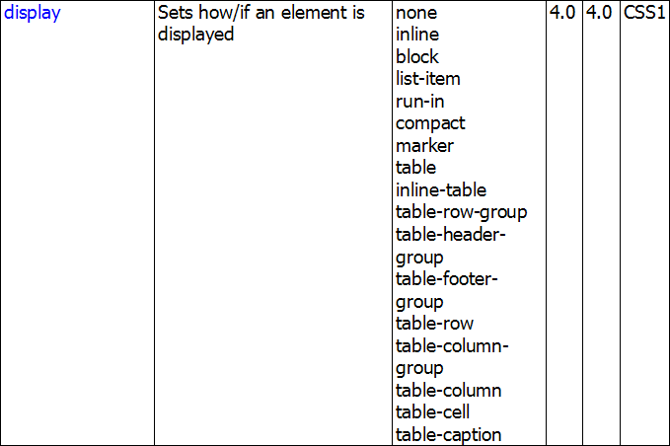
Other Attributes

Slide 46
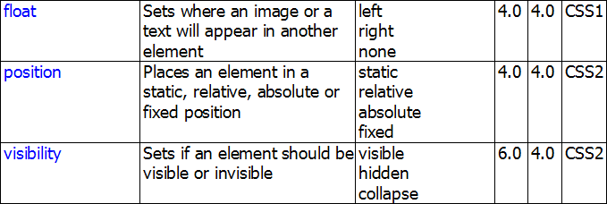
Other Attributes

Slide 47


Hey! Coding is easy!
END

